Slide 1
TITLE SLIDE

Slide 2
Shiny
2 parts to an app:
User-interface tab – controls how widgets/text are displayed and where on page
Server tab- controls computations/ creation of objects
Example: graphs are computed/data subsetted in server, then using output function they are displayed in UI tab.

Slide 3
You can make some features reactive meaning that they rely on output from other features.
Example: you only want a sidebar to popup after a certain button is pressed.
By using the isolate() function you can put off a function from running until a certain item’s input changes.
Can access what user inputs into widget with input$ “widget name”, can output to UI using output$ “outputname”.

Slide 4
Automatic Setup
User Action
server.r
defaultPlot()
filea <<-read.csv (example path)
Plot1 = pcaplot
Plot2 =scree plot
Input$
submit
Input$
go
Input$
go2
Input$
go3
Input$
donorbutton
Input$
stimulusbutton
Input$
timebutton
Input$
upload
Input$
select
plot1,plot2
If statement, type of algorithms used
ui.r
filea<<-parseFile()
subsetData()
Param/param2/param3 –
data
data2
setupPlot()
setupPlot()
setupPlot()
setupPlotDonor
setupPlotStimulus()
setupPlotTime()
sidebarPanel()
File Input
Filetype Input
Contains Header Input
Upload button
Data, data2 output
Param output
Data- ui for d,s,t selection
Data2 – ui for pca/ tsne selection and parameters
pcaPlot()
tsnePlot()
tsnePlotM()
shinyUI()
mainPanel()
Displays d,s,t buttons
prComp()
Rtsne()
Rtsne()
A calls B (function)
Input event
tabsetPanel()
A inputs to B (object)
function
Displays plot1,plot2
Observe event

Slide 5
Explanation of graph
Setup phase:
program automatically parses default data which is used to create default table.
UI is setup with main panel, sidepanel, and tabset .
Table is displayed in mainpanel, file upload displayed in sidepanel.
User-Action:
Input$upload – parses file into global variable filea. Renders dst selection menu.
Input$select creates global variable subsetgenes using dst selected. Renders algo/dim menu.
Input$submit – displays param selection menu depending on algo slected.=

Slide 6
input$go- renders just pca plot.
input$go2 – renders just tsne plot.
Input$go3- renders pca+tsne plot.
setupPlot(Donor,Time,Stimulus) – sets up the current plot but with traces according to the option selected.

Slide 7
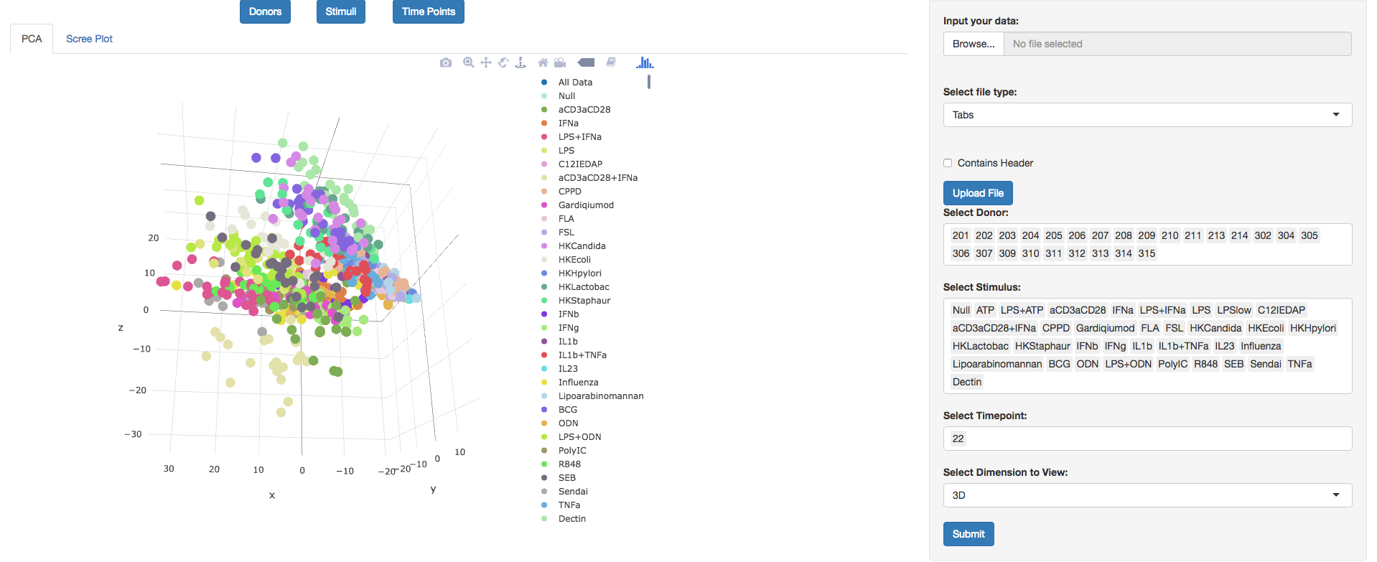
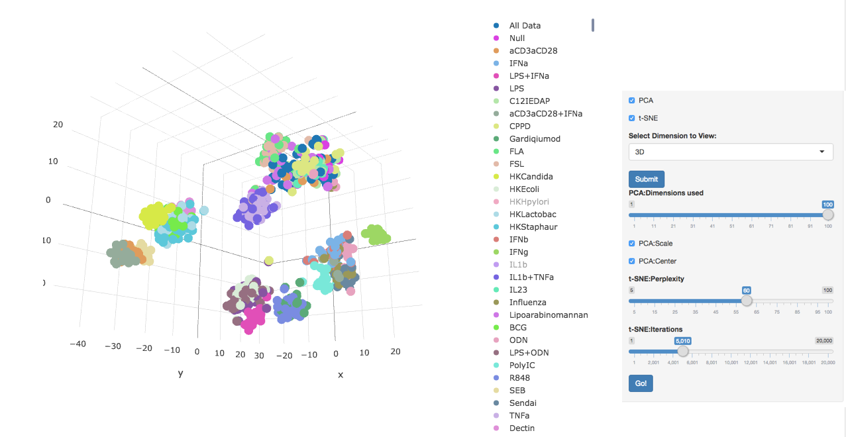

Slide 8
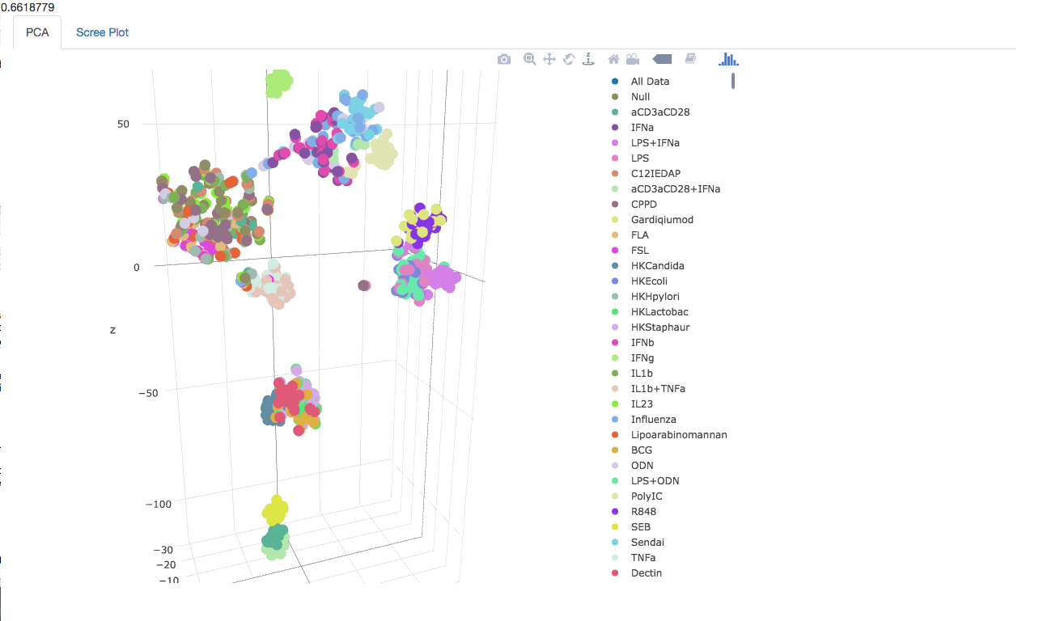
Perplexity = 20

Slide 9
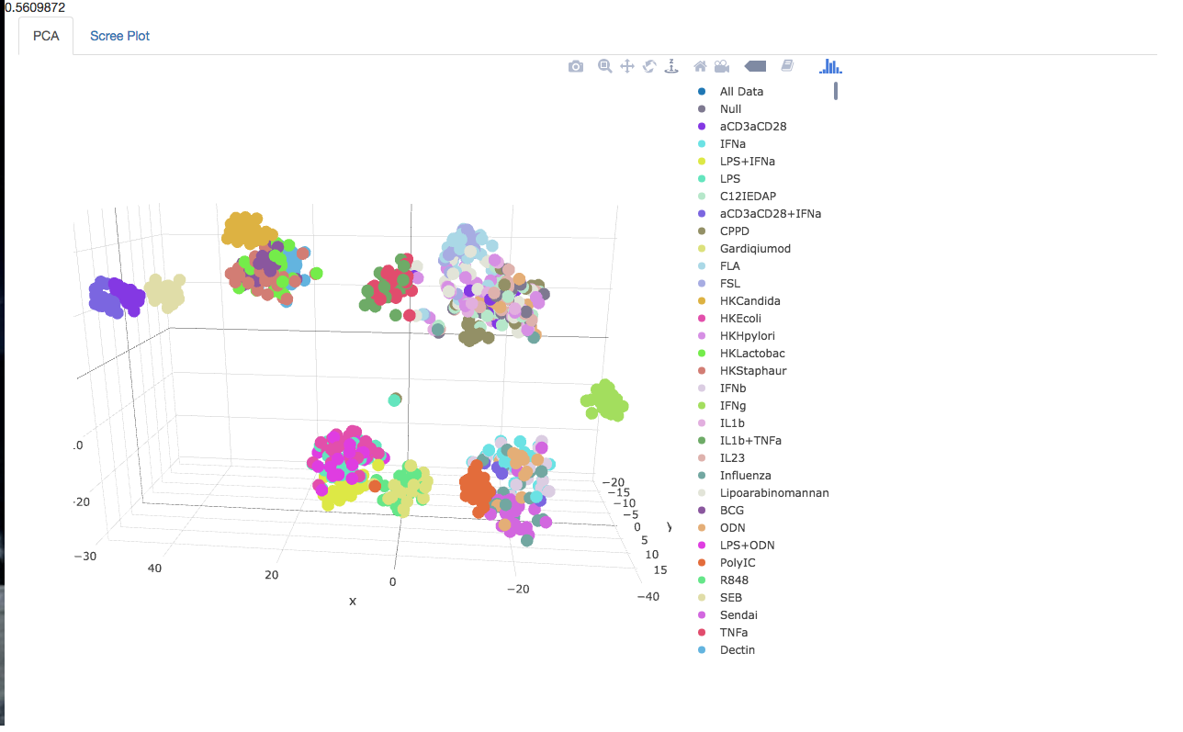
Perplexity = 40

Slide 10
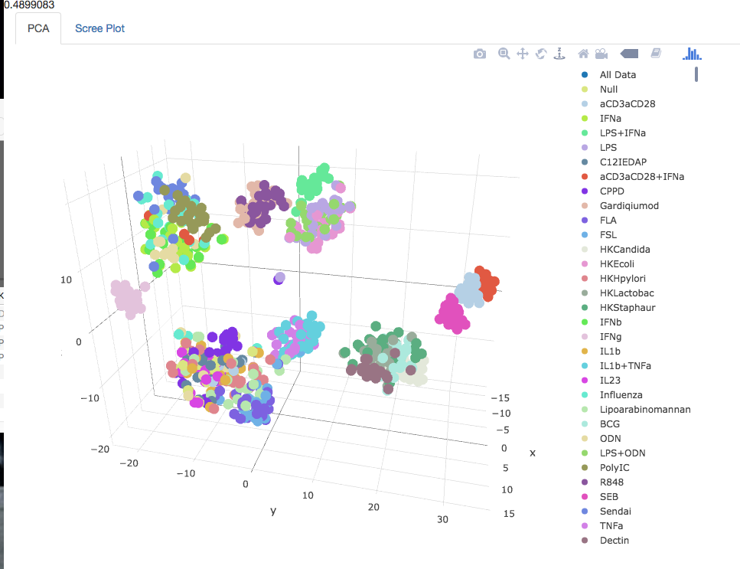
Perplexity = 60

Slide 11



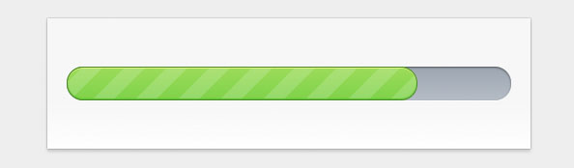
Difficulties
Hover labels
Lots of buttons/ ui
Progress bar

